Slide 1
AI Capstone
May 2023
License Plate Recognition and Classification using Computer Vision using Optical Character Recognition and Fourier Transformations
Melek Mizher
MSDS 490 AI Capstone

Slide 2
Introduction / Problem Statement
Reading License Plate Data
Applications of License Plate Recognition in context of IoT
Components of ALPR Systems
Challenges of ALPR Systems
Notes:
Importance in law enforcement, surveillance, and surveying. Challenges include variations in weather, lighting, license plate designs, and other factors.

Slide 3
Methods and Research Design
Four Main Aspects:
Extracting License Plates using pre-trained YOLOv8 model.
Image Processing and Reorientation.
Extracting Plate Number using Optical Character Recognition.
Classifying License Plate based on Image Data.

Slide 4
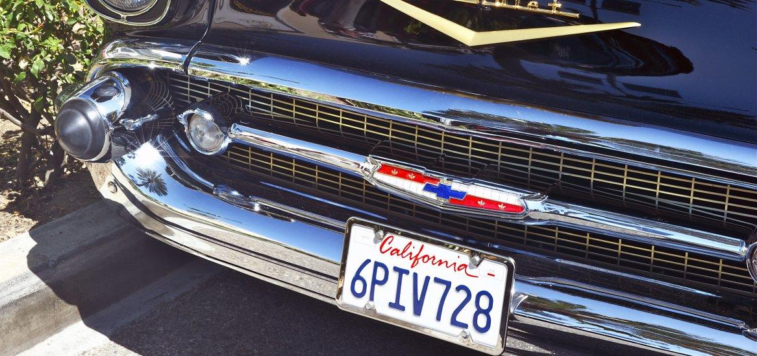
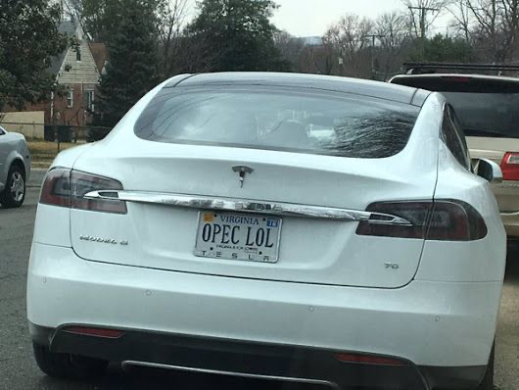
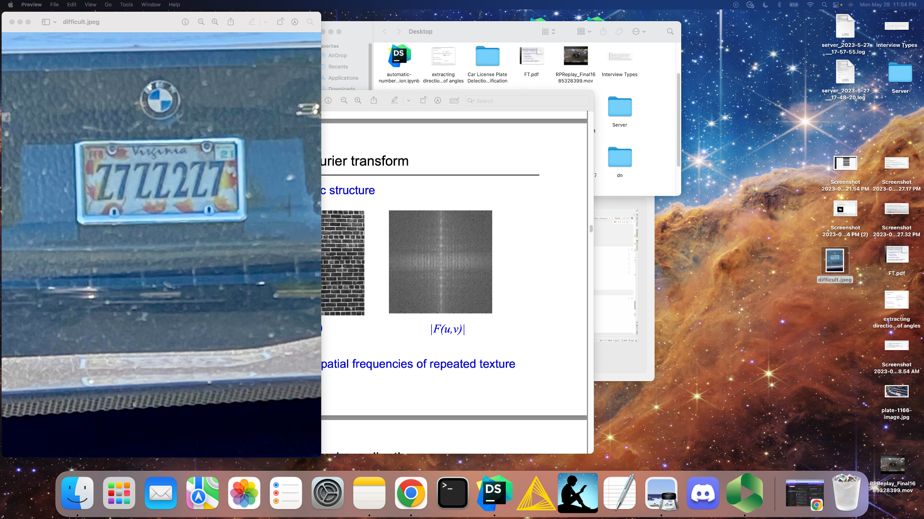
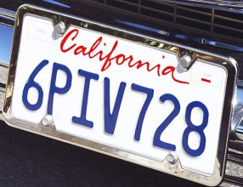
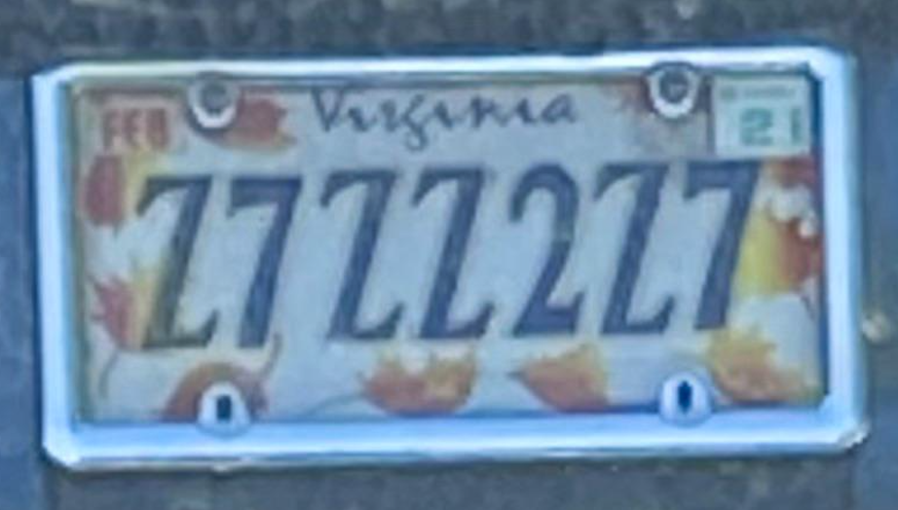
Methods and Research Design
Extracting License Plates using pre-trained YOLOv8 model.

Slide 5
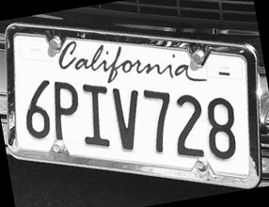
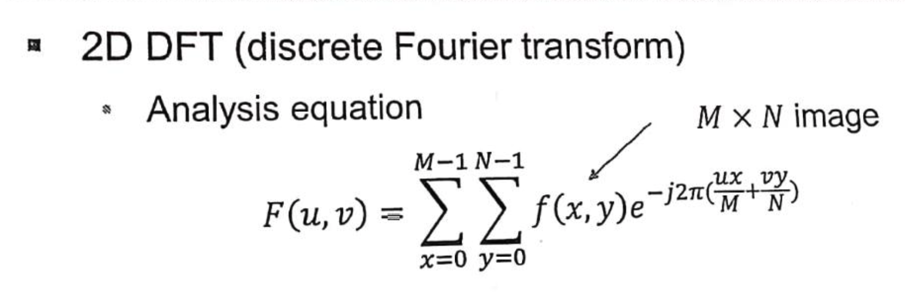
Methods and Research Design
Image Processing and Reorientation with Fourier Transformation
Input Output
Image Processing
Image Padding (30% per dimension)
Grayscale Conversion
2D Discrete Fourier Transformation
Image Rotation and Resampling
Gaussian Blur Image Filtering
Cropping of Image Padding
Notes:
Bicubic Resampling

Slide 6
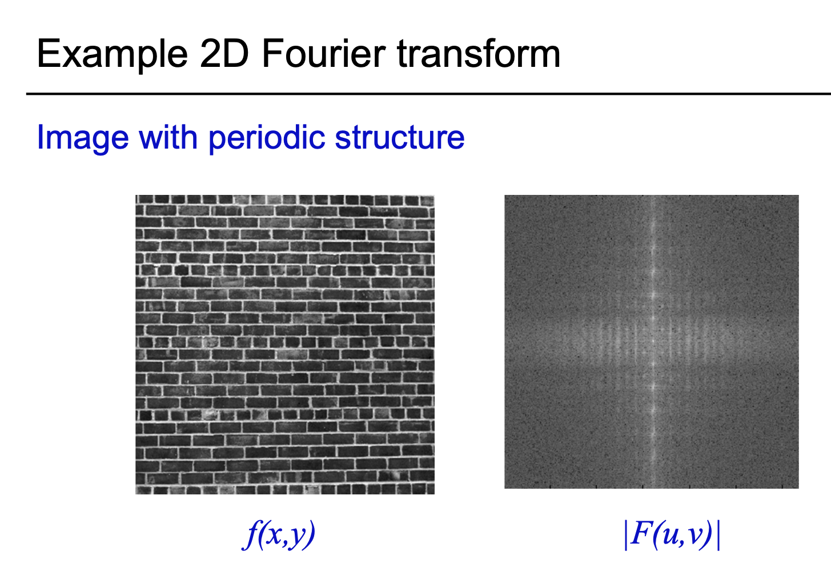
Methods and Research Design
Image Processing and Reorientation with Fourier Transformation
Fourier Method is not efficient for every case.
Two other processing methods are used based on confidence calculations.
“Soft” method
Binary method
Source: A. Zisserman, University of Oxford.

Slide 7
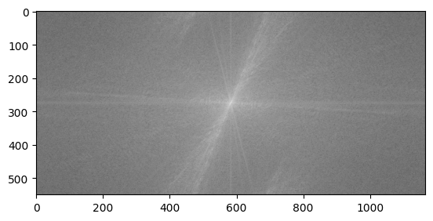
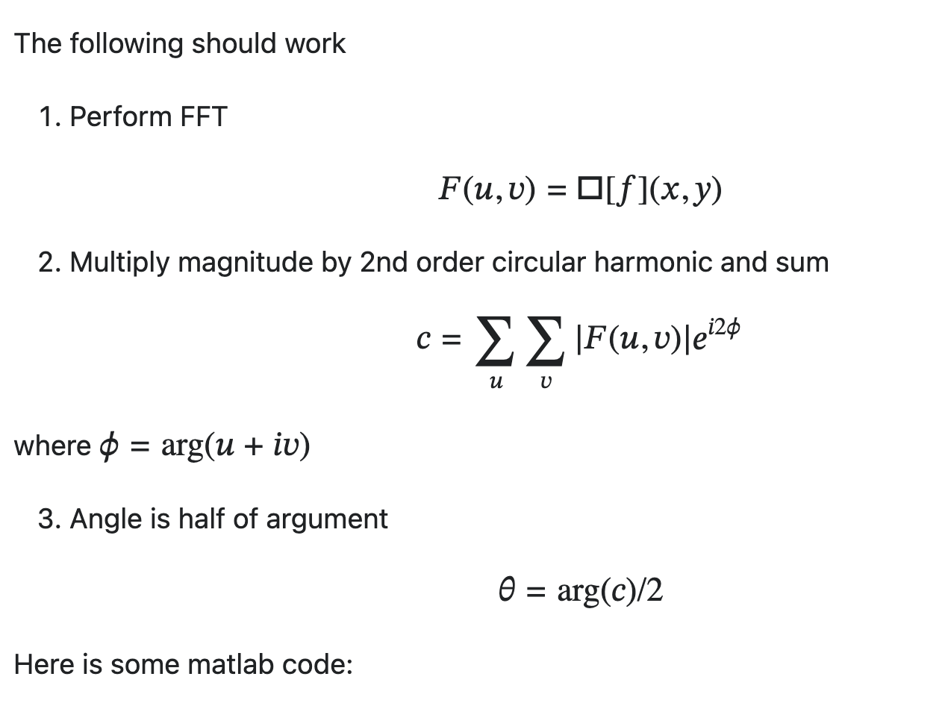
Methods and Research Design
Image Processing and Reorientation with Fourier Transformation
Input Output
Fourier Transformation
Complex Argument
Angle of Complex Argument
Notes:
Fournier Transformation: Uses image x, y to generate a frequency distribution.
Complex Argument: Calculated using Absolute value of the Magnitude of FT multiplied by the Second Circular Harmonic e^i2φ
Argument can be explained as the angle between the positive real axis and line joining origin and z as a point in the complex plane.

Slide 8
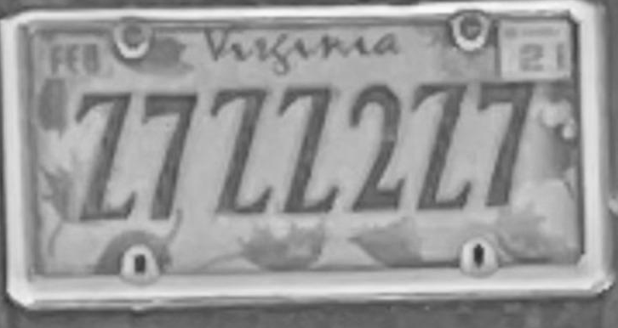

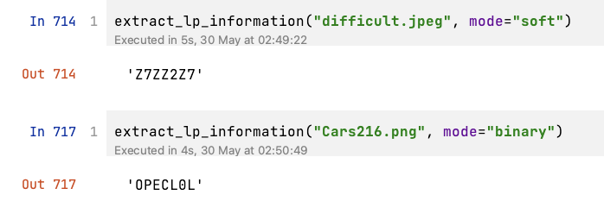
Methods and Research Design
Extracting Plate Number using Optical Character Recognition.
Fourier Method Soft Method Binary Method

Slide 9
Recommendations for Further Study
Classifying License Plate type based on other Image Data.
Challenges of Extracting Other Image Data.
Areas for Improvement
Future of ALPR

Slide 10
Executive Summary
There are many challenges connected with correctly identifying license plate numbers such as distance, angles, lighting and other environmental conditions.
There are many applications for this technology including law enforcement, toll collection and enforcement, automatic vehicle access, and surveying.
Challenges remain for identifying additional information from license plates, mostly due to license plate design variations and color contrast.

